Slide 1
Data Science (DS 01)
Statistics

Slide 2
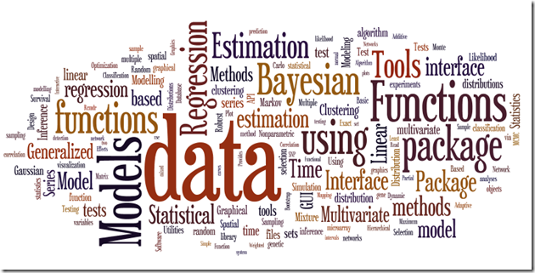
What is statistics ?
It is the methodology for collecting, analyzing, interpreting and drawing conclusions from information.

Slide 3
Statistical Methods
Design:
Planning and carrying out research studies.
Description:
Summarizing and exploring data.
Inference:
Making predictions and generalizing about phenomena represented by the data.

Slide 4
Applications of Statistics
Agricultural problem:
Is new grain seed or fertilizer more productive?
Medical problem:
What is the right amount of dosage of drug to treatment?
Political science:
How accurate are the gallups and opinion polls?
Economics:
What will be the unemployment rate next year?
Technical problem:
How to improve quality of product?

Slide 5
Basic concepts
Population:
Population is the collection of all individuals or items under consideration in a statistical study.
Sample:
Sample is that part of the population from which information is collected.

Slide 6
Types of Statistics
Descriptive Statistics
Frequencies & percentages
Means & standard deviations
Inferential Statistics
Correlation
T-tests
Chi-square
Logistic Regression

Slide 7
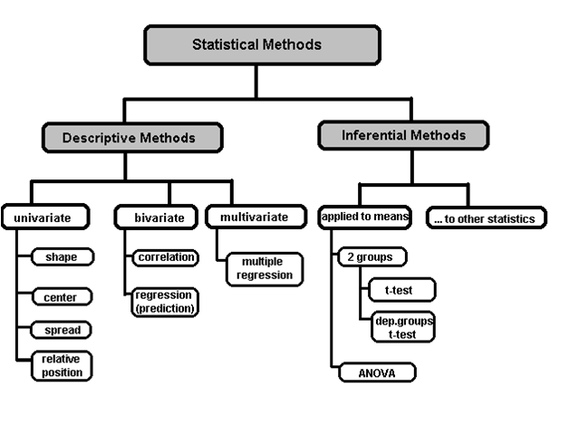

Slide 8
Formulate the Problem
Define Population and Sample
Report the results
Collect Data
Do Descriptive Analysis
Use Proper statistical methods

Slide 9
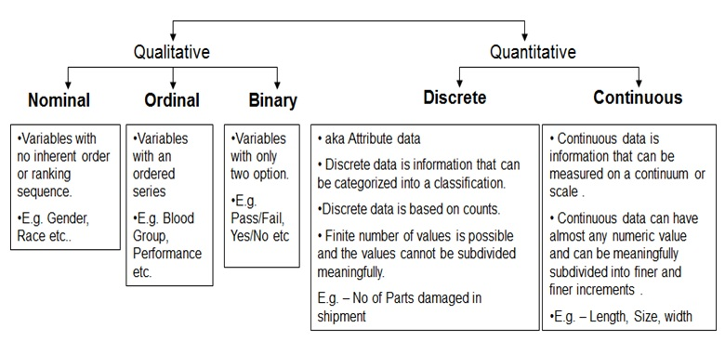
Variables

Slide 10
Variables
Variables are the quantities measured in a sample.
Quantitative i.e. numerical
Continuous (e.g. pH of a sample, patient cholesterol levels)
Discrete (e.g. number of bacteria colonies in a culture)
Categorical
Nominal (e.g. gender, blood group)
Ordinal (ranked e.g. mild, moderate or severe illness). Often ordinal variables are re-coded to be quantitative.

Slide 11
Variables
Variables can be further classified as:
Dependent/Response. Variable of primary interest (e.g. blood pressure in an antihypertensive drug trial). Not controlled by the experimenter.
Independent/Predictor
called a Factor when controlled by experimenter. It is often nominal (e.g. treatment)
Covariate when not controlled.
If the value of a variable cannot be predicted in advance then the variable is referred to as a random variable

Slide 12
Descriptive Statistics
Measures of Central Tendency
Measures of Spread / Variability / Dispersion
Measures of Shape

Slide 13
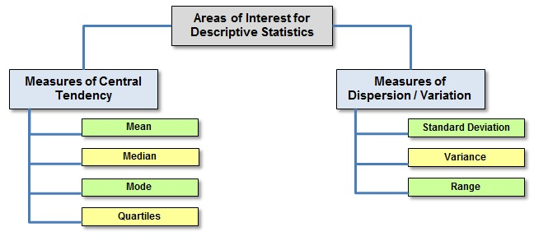
Descriptive Statistics

Slide 14
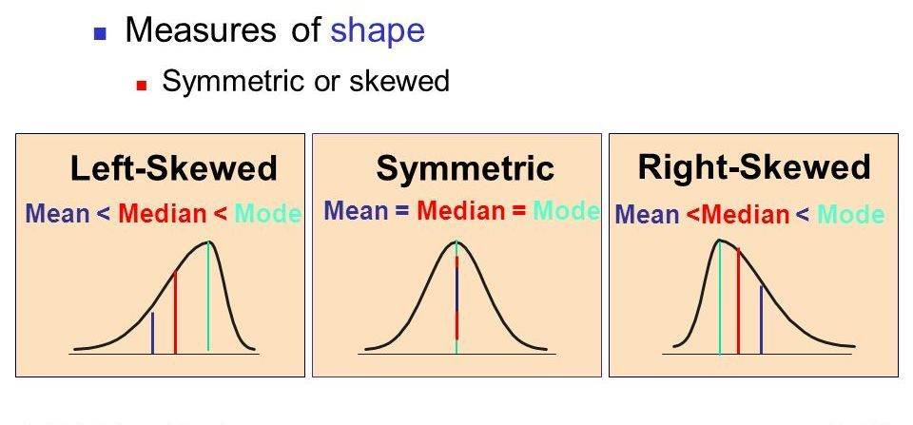
Descriptive Statistics

Slide 15
Measures of Central Tendency
Common measures of location are:
Arithmetic Mean,
Median,
Mode

Slide 16
Mean
Let x₁,x₂,x₃,…,x_{n} be the realised values of a random variable X, from a sample of size n. The sample arithmetic mean is defined as:

Slide 17
Mean
The systolic blood pressure of seven middle aged men were as follows:
151, 124, 132, 170, 146, 124 and 113.
The mean is

Slide 18
Median and Mode
If the sample data are arranged in increasing order, the median is
the middle value if n is an odd number, or
midway between the two middle values if n is an even number
The mode is the most commonly occurring value.

Slide 19
Example 1-n odd
The reordered systolic blood pressure data seen earlier are:
113, 124, 124, 132, 146, 151, and 170.
The Median is the middle value of the ordered data, i.e. 132.
Two individuals have systolic blood pressure = 124 mm Hg, so the Mode is 124.

Slide 20
Example 2-n even
Six men with high cholesterol participated in a study to investigate the effects of diet on cholesterol level. At the beginning of the study, their cholesterol levels (mg/dL) were as follows:
366, 327, 274, 292, 274 and 230.
Rearrange the data in numerical order as follows:
230, 274, 274, 292, 327 and 366.
The Median is half way between the middle two readings, i.e. (274+292) ÷ 2 = 283.
Two men have the same cholesterol level- the Mode is 274.

Slide 21
Mean vs Median
Large sample values tend to inflate the mean. This will happen if the histogram of the data is right-skewed.
The median is not influenced by large sample values and is a better measure of centrality if the distribution is skewed.
Note if mean=median=mode then the data are said to be symmetrical
e.g. In the CK measurement study, the sample mean = 98.28. The median = 94.5, i.e. mean is larger than median indicating that mean is inflated by two large data values 201 and 203.

Slide 22
Measures of Spread
Common measures of location are:
Range
Inter-Quartile range
Variance
Standard deviation

Slide 23
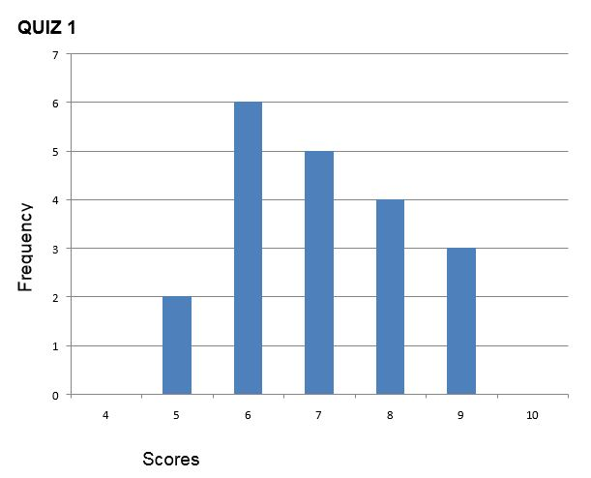
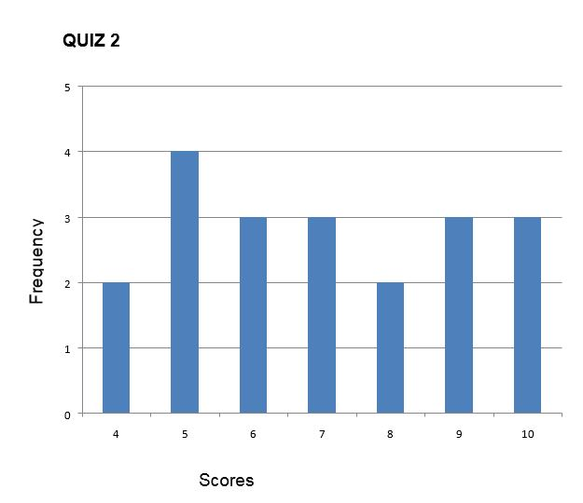
Measures of Spread
Distribution of scores for Quiz 1 and Quiz 2
The mean score for both quizzes is 7. The scores on Quiz 1 are more packed or clustered around the mean, whilst the scores on Quiz 2 are more spread out. Thus, the differences within the student group were greater on Quiz 2 than on Quiz 1.

Slide 24
Range:
The most basic measure of variation is the range, which is the distance from the smallest to the largest value in a distribution.
Range= Largest value – Smallest Value

Slide 25
Range:
For the distribution of scores of Quiz 1 and Quiz 2
the range is:
Quiz 1 : Range = 9-5= 4
Quiz 2 : Range = 10-4= 6
Quiz 2 scores have greater spread than Quiz 1 scores.
However, the range uses only two values in the data set, and one of these values may be an unusually large or small value.

Slide 26
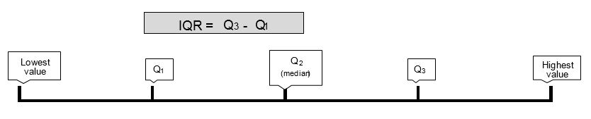
Interquartile Range
The interquartile range (IQR) is the range of the middle 50% scores in a distribution:
IQR= 75th percentile – 25th percentile

Slide 27
Interquartile Range
Identify the IQR for Quiz 1 & Quiz 2

Slide 28
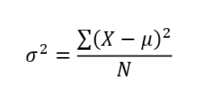
Variance
The variance is the average squared difference of the scores from the mean.
To compute the variance in a population:
Calculate the mean
Subtract the mean from each score to compute the deviation from mean score
Square each deviation score (multiply each score by itself)
Add up the squared deviation score to give the sum
Divide the sum by the number of scores

Slide 29
Variance
To calculate variance in a population looks like:
Where o² is the variance
µ is the mean of a population
X are the values or scores
N is the number of values or scores

Slide 30
Variance
If the variance in a sample is used to estimate the variance in a population, it is important to note that samples are consistently less variable than their populations:
The sample variability gives a biased estimate of the population variability.
This bias is in the direction of underestimating the population value.
In order to adjust this consistent underestimation of the population variance, we divide the sum of the squared deviation by N-1 instead of N.

Slide 31

Variance
To calculate variance in a Sample looks like:
s² is the variance of the sample
M is the sample mean
X are the values or scores
N is the number of values or scores in the sample

Slide 32
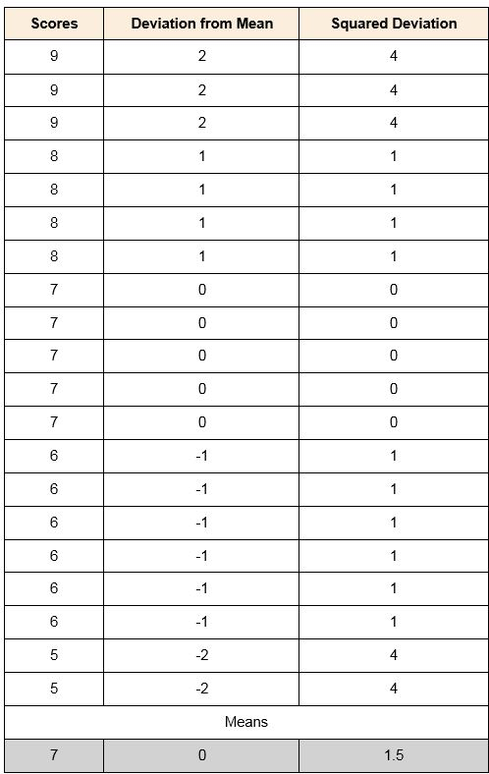
Variance
calculate the variance

Slide 33

Standard Deviation
The standard deviation is the average amount by which scores differ from the mean. The standard deviation is the square root of the variance

Slide 34

Standard Deviation
The sample standard deviation formula is:
s = sample standard deviation = sum of... = sample mean n = number of scores in sample.

Slide 35
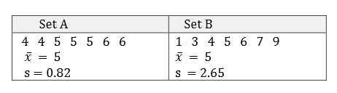
Standard Deviation
A small SD coeff = small degree of variability (that is, scores are close together)
Larger SD coeff = large variability (that is, scores are far apart).

Slide 36
Standard Deviation
Q. A teacher sets an exam for their pupils. The teacher wants to summarize the results the pupils attained as a mean and standard deviation. Which standard deviation should be used?
A. Population standard deviation. Why? Because the teacher is only interested in this class of pupils' scores and nobody else.

Slide 37
Standard Deviation
Q. A researcher has recruited males aged 45 to 65 years old for an exercise training study to investigate risk markers for heart disease (e.g., cholesterol). Which standard deviation would most likely be used?
A. Sample standard deviation. Although not explicitly stated, a researcher investigating health related issues will not simply be concerned with just the participants of their study; they will want to show how their sample results can be generalised to the whole population (in this case, males aged 45 to 65 years old). Hence, the use of the sample standard deviation.

Slide 38
Standard Deviation
Q. One of the questions on a national consensus survey asks for respondents' age. Which standard deviation would be used to describe the variation in all ages received from the consensus?
A. Population standard deviation. A national consensus is used to find out information about the nation's citizens. By definition, it includes the whole population. Therefore, a population standard deviation would be used.

Slide 39
Measures of Shape
Skewness
Kurtosis

Slide 40
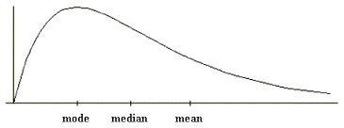
Measures of Shape
Distributions can be asymmetrical or skewed; that is, the tail of the distribution in the positive direction extends further than the tail in the negative direction, or vice versa.
A distribution with the longer tail extending in the positive direction is said to have a positive skew; it is skewed to the right.

Slide 41
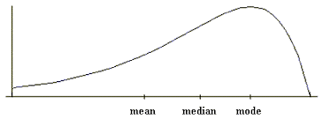
Measures of Shape
A distribution with the longer tail extending to the left is negatively skewed, or skewed to the left:

Slide 42
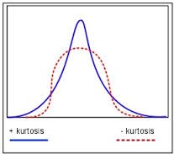
Measures of Shape
Distributions also differ in terms of whether the data are peaked or flat.
Distributions with positive kurtosis have a distinct peak near the mean and decline rapidly, whilst distributions with negative kurtosis tend to be more flat.

Slide 43
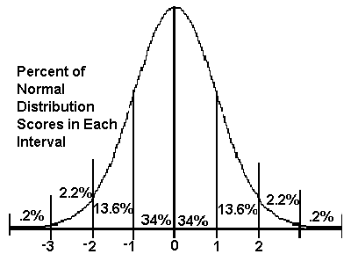
Normal Distributions
The normal distribution is the most important and commonly used distribution in statistics. It is also known as the bell curve or Gaussian curve.

Slide 44
Normal Distributions - Characteristics
They are symmetric around their mean
The mean, median, and mode are equal
Are denser in the center and less dense in the tails
Are defined by two parameters: the mean and standard deviation
68% of the area is within one standard deviation of the mean
Approximately 95% of the area is within two standard deviations of the mean
99.7 % of the area is within 3 standard deviations of the mean.

Slide 45
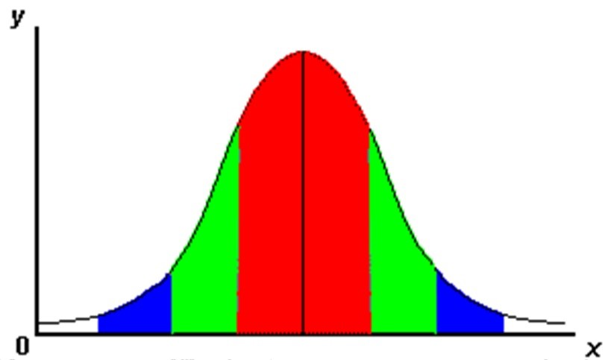
The 68-95-99.7% rule
Standard normal deviations follow the 68-95-99.7% rule:
68% of scores are within one standard deviation of the mean.
95% of scores are within 2 standard deviations of the mean.
99.7% of scores are within 3 standard deviations of the mean.

Slide 46
Normal Distributions
Knowing the mean and standard deviation of a normal distribution, we can calculate the values that lie within 1 standard deviation of the mean.
For example, if the mean of a normal distribution is 25 years (age) and the standard deviation is 8 years, then:
68% of people will be between 17 (25-8= 17) and 33 years ( 25+8= 33).

